Slide 1

Rockbuster Stealth New Video Service
By: Rebeca Martinez

Slide 2



Project Motivation
Rockbuster Stealth LLC is a movie rental company that used to have stores around the world. Facing stiff competition from streaming services such as Netflix and Amazon Prime, the Rockbuster Stealth management team is planning to use its existing movie licenses to launch an online video rental service in order to stay competitive.

Slide 3

Key Questions
● Which movies contributed the most/least to revenue gain?
● What was the average rental duration for all videos?
● Which countries are Rockbuster customers based in?
● Where are customers with a high lifetime value based?
● Do sales figures vary between geographic regions?

Slide 4
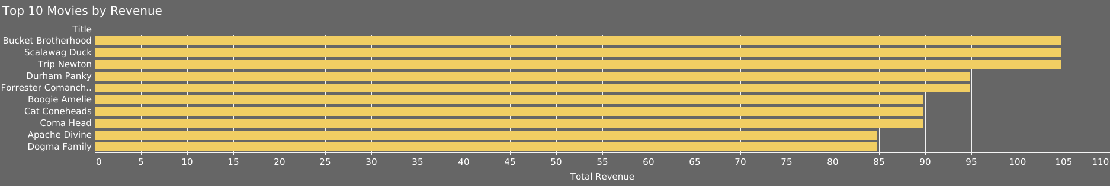
Top Movies for Most Revenue
“Trip Newton”, “Scalawag Duck”, “Bucket Brotherhood” = $104.79
“Durham Panky”, “Forrester Comancheros” = $ 94.81

Slide 5
Top Movies for Least Revenue
Title of Movies | Total Revenue
Holes Brannigan | $0.00
Princess Giant | $0.00
Smoking Barbarella | $0.00
Women Dorado | $0.00
State Wasteland | $0.00
Motions Details | $0.00
Sleepy Japanese | $0.00
Movie Shakespeare | $0.00
Curtain Videotape | $0.00
Chamber Italian | $0.00

Slide 6
Rental Durations
Max Durations:
7 Days
Min Durations:
3 Days
Average Durations:
5 Days

Slide 7
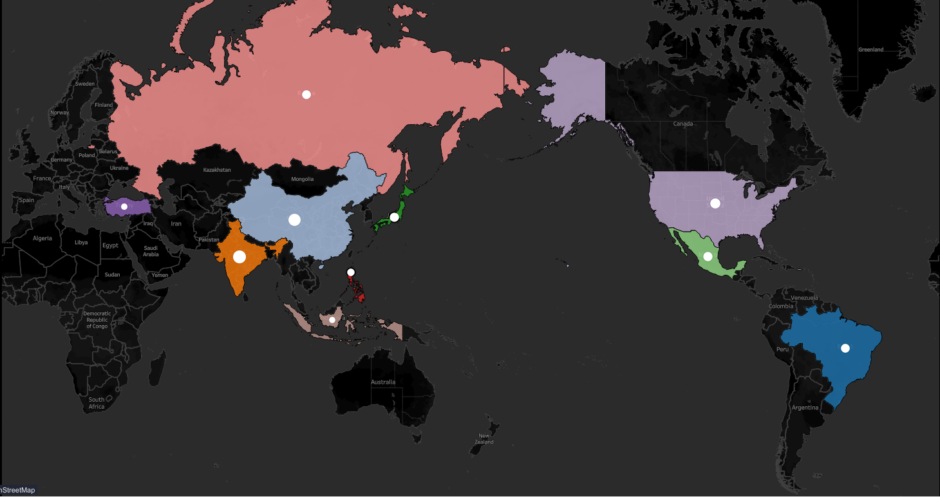
Countries Rockbuster Customers are Based in
Country | Total Customers
India | 60
China | 53
United States | 36
Japan | 31
Mexico | 30
Brazil | 28
Russian Federation | 28
Philippines | 20
Turkey | 15
Indonesia | 14

Slide 8
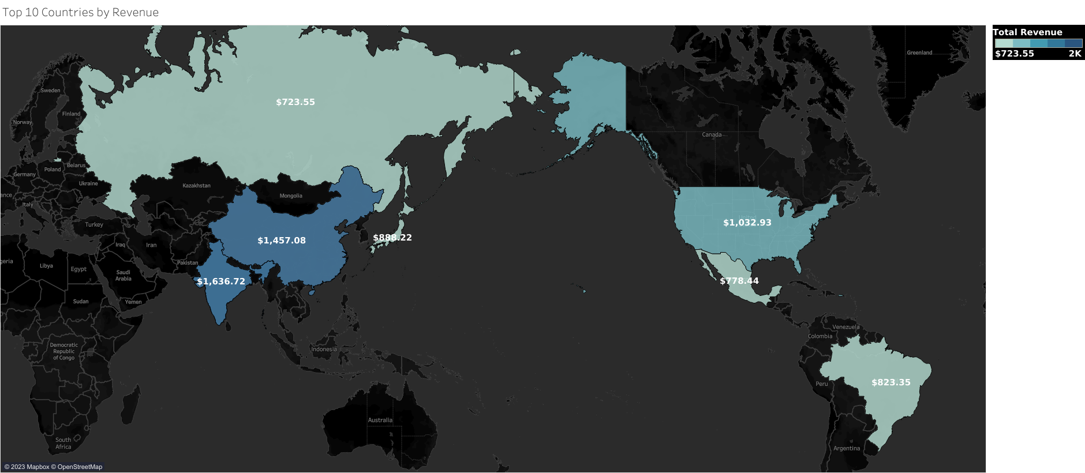
Countries Rockbuster Customers are Based in
Country | Total Revenue
India | 1636.72
China | 1457.08
United States | 1032.93
India | 938.86
China | 899.99
Japan | 888.22
Brazil | 823.35
Mexico | 778.44
India | 754.74
Russian Federation | 723.55

Slide 9
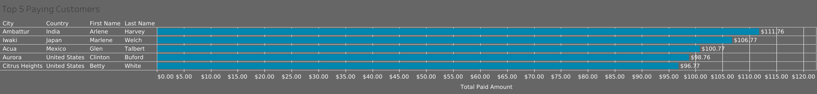
Top 5 Most Valued Customers
India, Japan, Mexico, and the United States contain our Top 5 highest paying customers.
United States appears twice in this list.

Slide 10
Conclusions
India, China, and the United States are the top 3 countries in revenue and customer count.
Asia had the most customers out of all the regions
Recommendations
Give top customers a sneak peak of the platform to create social media buzz and to get honest feedback.
Focus marketing on countries like India, China and the US.
Market top movies to let regular customers know their favorite movies are going to be on the platform .

Slide 11

Thank You! Any questions?

Slide 12
Tableau Visualizations
https://public.tableau.com/app/profile/rebeca.martinez/viz/Top5PayingCustomers/Top5PayingCustomers
https://public.tableau.com/app/profile/rebeca.martinez/viz/Top10MoviesbyReveneue/Top10Movies
https://public.tableau.com/app/profile/rebeca.martinez/viz/Top10CountriesbyRevenue_16992383596580/Top10Countries
https://public.tableau.com/app/profile/rebeca.martinez/viz/MapofCutomersbyCountry/Sheet1

